Slide 1
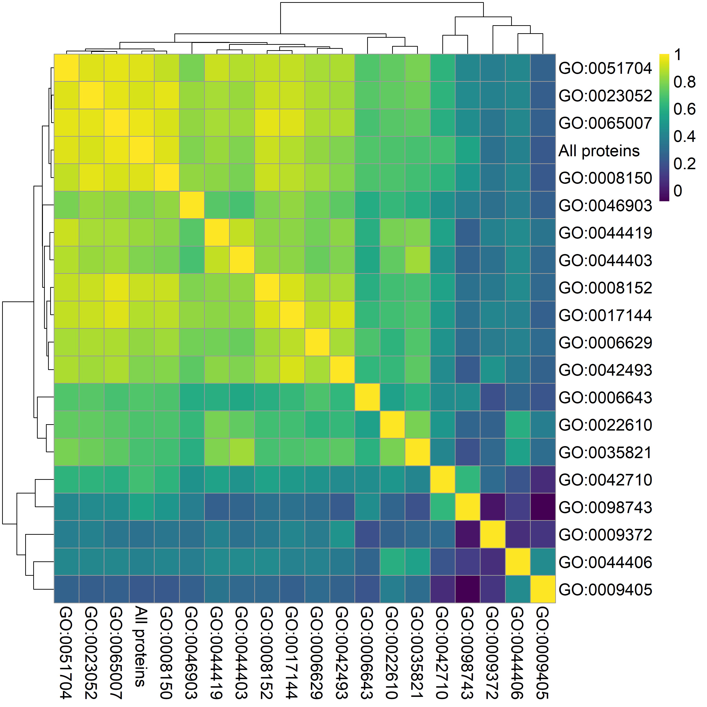
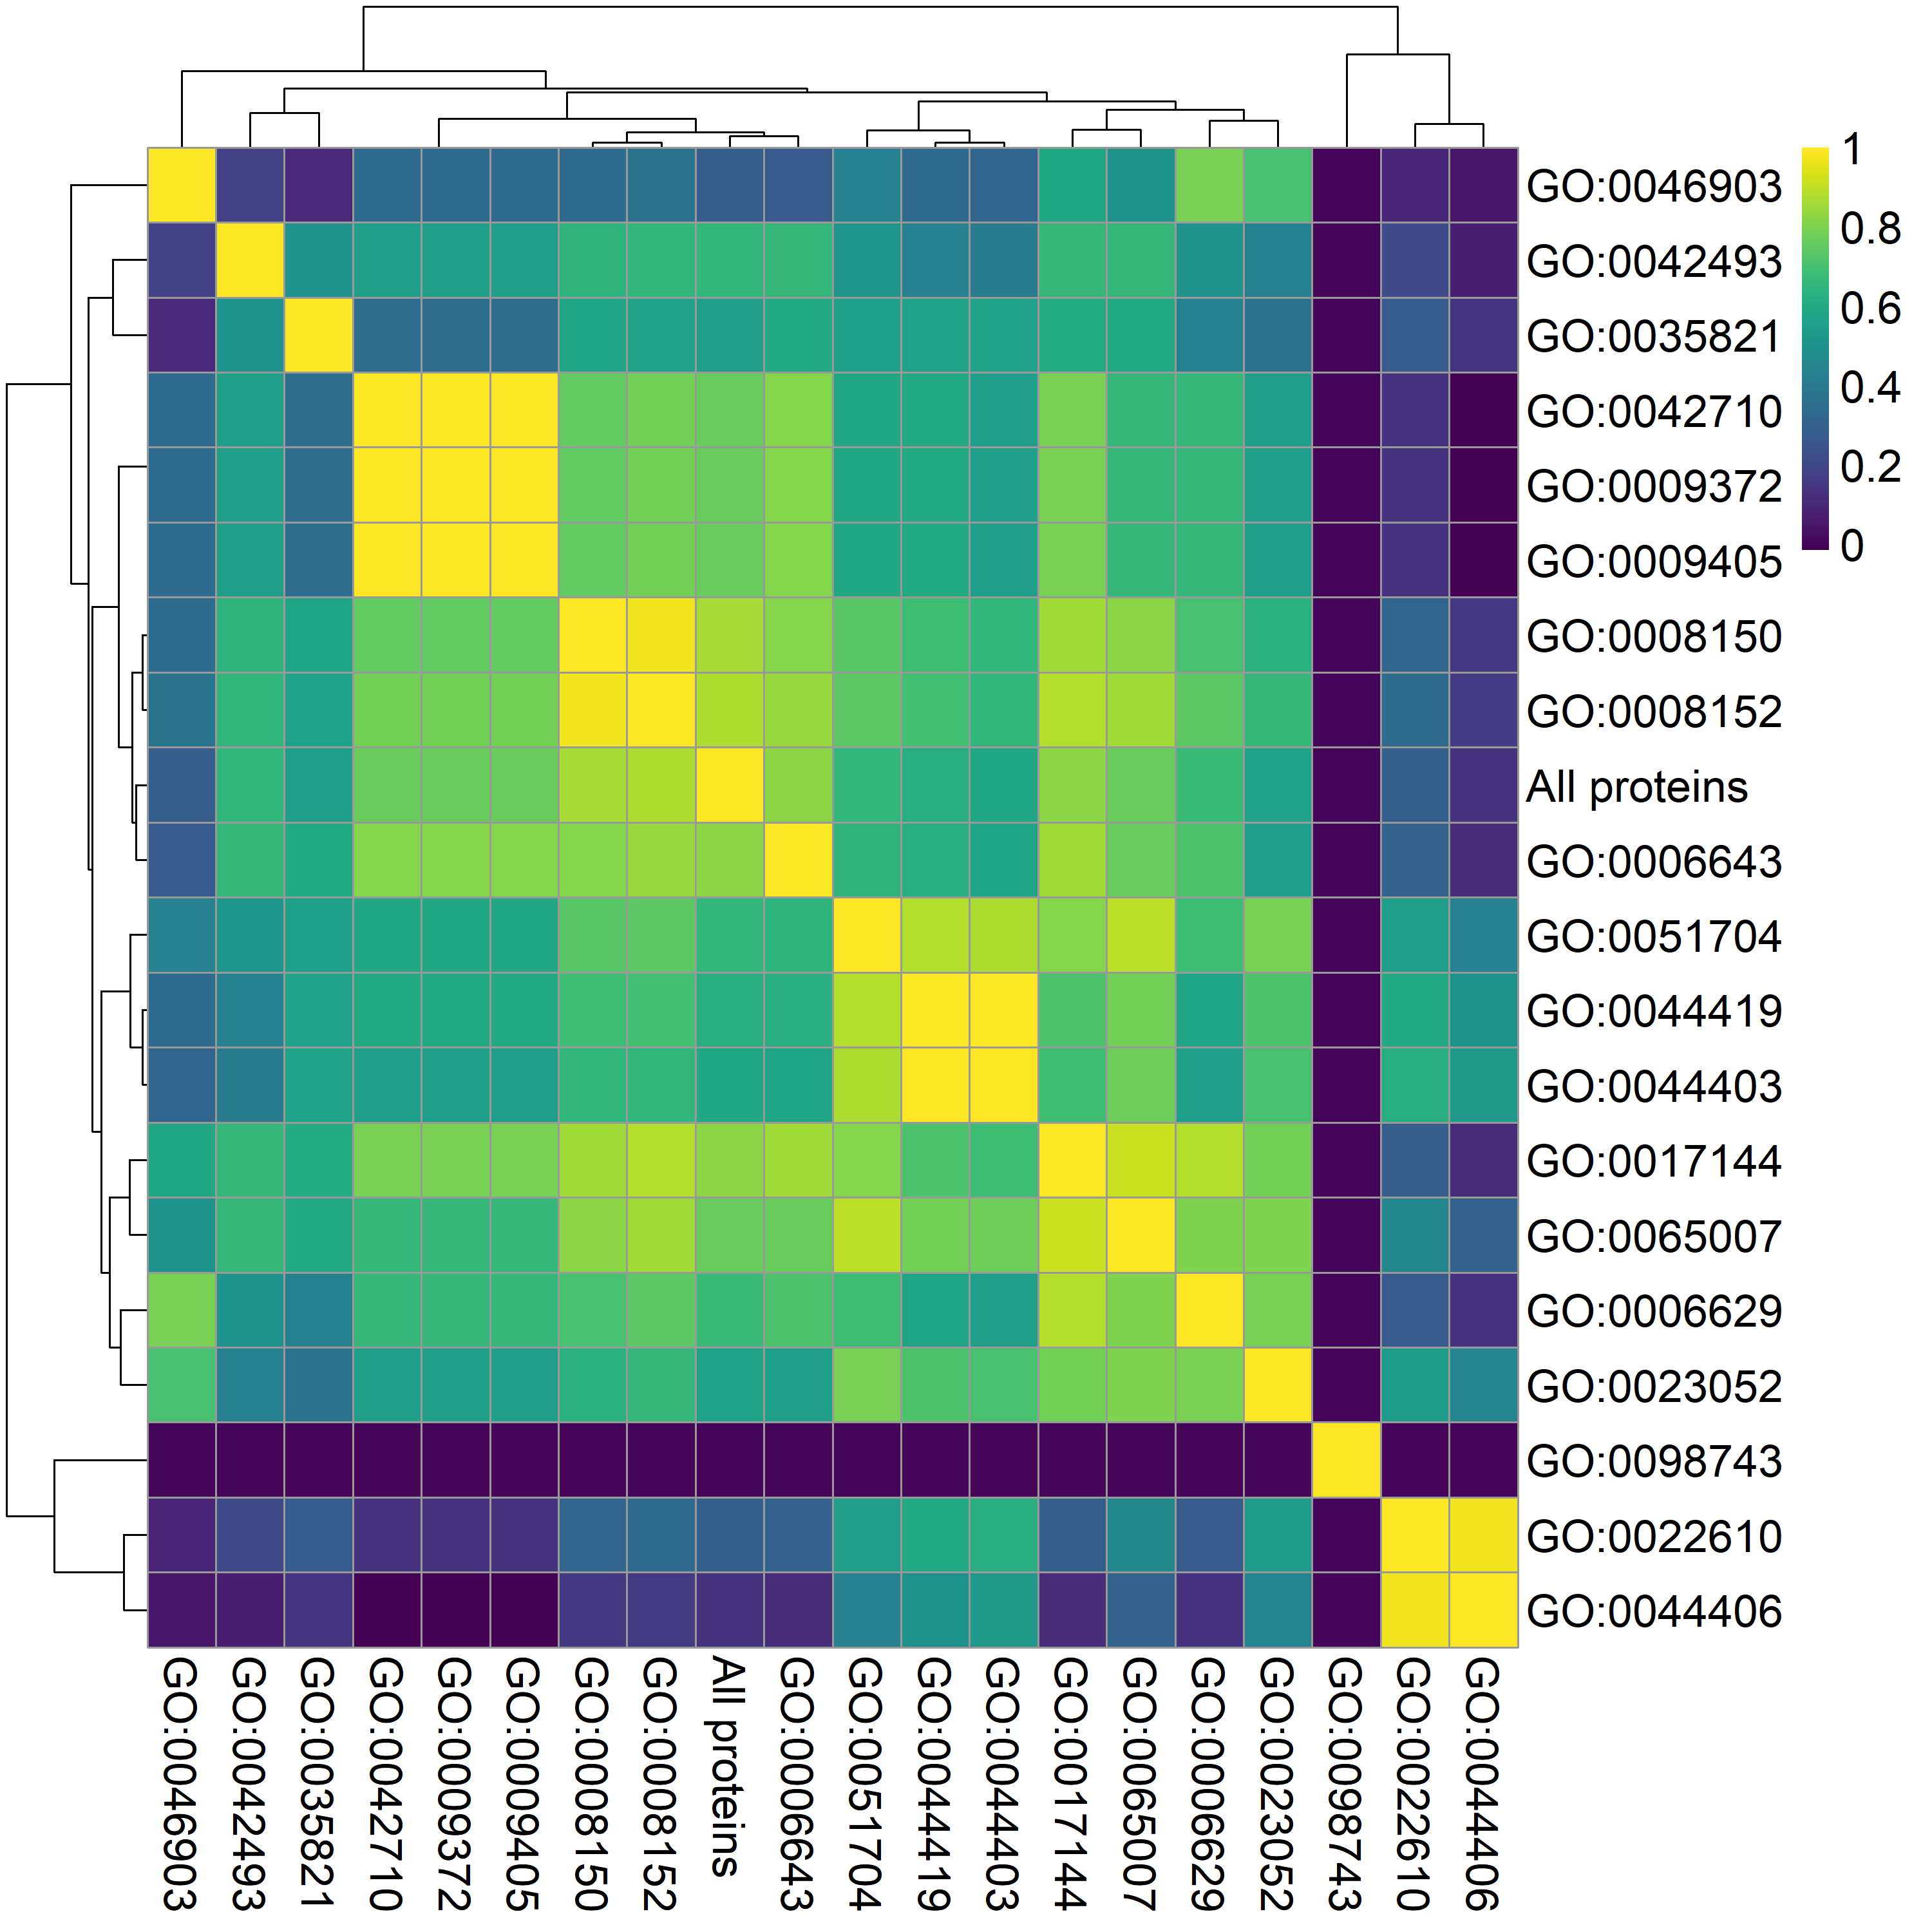
Notes:
Left, all mycoplasma with 12 mpn, Right mpn only

